Slide 1

CHAPTER 4
ELEMENTARY NUMBER THEORY AND METHODS OF PROOF
Copyright © Cengage Learning. All rights reserved.

Slide 2

4.5
Direct Proof and Counterexample Ⅴ: Division into Cases and the Quotient-Remainder Theorem
Copyright © Cengage Learning. All rights reserved.

Slide 3
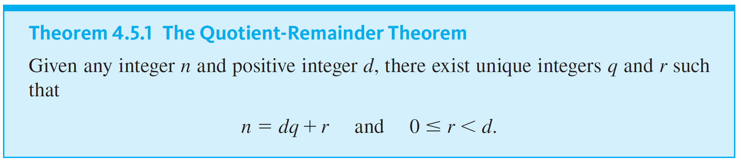
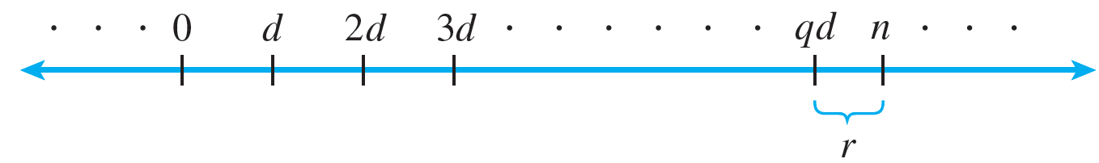
Direct Proof and Counterexample Ⅴ: Division into Cases and the Quotient-Remainder Theorem
If n is positive, the quotient-remainder theorem can be illustrated on the number line as follows:

Slide 4
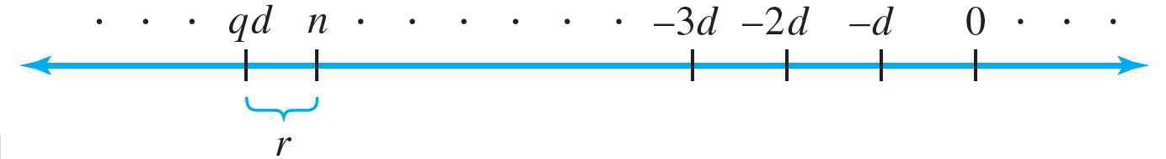
Direct Proof and Counterexample Ⅴ: Division into Cases and the Quotient-Remainder Theorem
If n is negative, the picture changes. Since n = dq + r, where r is nonnegative, d must be multiplied by a negative integer q to bring dq either exactly to n (in which case r = 0) or to a point below n (in which case the positive integer r is added to bring dq + r back up to n).
This is illustrated as follows:

Slide 5
Example 4.5.1 – The Quotient-Remainder Theorem
For each of the following values of n and d, find integers q and r such that n = dq + r and 0 ≤ r < d.
a. n = 54, d = 4
b. n = −54, d = 4
c. n = 54, d = 70

Slide 6
Example 4.5.1 – Solution
a. 54 = 4 · 13 + 2; hence q = 13 and r = 2.
b. −54 = 4 ·(−14) + 2; hence q = −14 and r = 2.
c. 54 = 70 · 0 + 54; hence q = 0 and r = 54.

Slide 7
div and mod

Slide 8
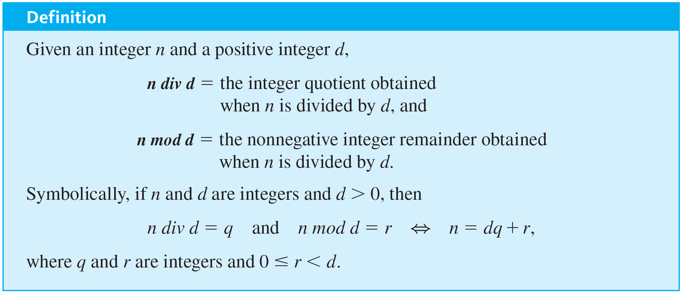
div and mod

Slide 9
Example 4.5.2 – Computing div and mod by Hand or with a Four-Function Calculator
Compute 32 div 9 and 32 mod 9 by hand or with a four-function calculator.

Slide 10
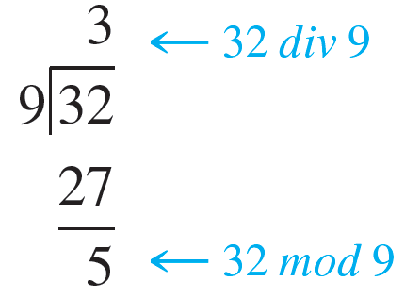
Example 4.5.2 – Solution
Performing the division by hand gives the following results:
To use a four-function calculator to compute n div d for a nonnegative integer n and a positive integer d, just divide n by d and ignore the part of the answer to the right of the decimal point.

Slide 11
Example 4.5.2 – Solution
continued
To compute n mod d, substitute n div d in place of q and n mod d in place of r in the equation n = dq + r. The result is
n = d ·(n div d) + n mod d.
Solving for n mod d gives
n mod d = n − d ·(n div d).
Thus when you use a four-function calculator to divide 32 by 9, you obtain an expression like 3.555555556. Discarding the fractional part gives 32 div 9 = 3, and so
32 mod 9 = 32 − 9 ·(32 div 9) = 32 − 27 = 5.

Slide 12
Example 4.5.4 – Solving Problems about mod
a. Prove that if n is a positive integer, then n mod 10 is the digit in the ones place in the decimal representation for n.
b. Suppose m is an integer. If m mod 11 = 6, what is 4m mod 11?

Slide 13
Example 4.5.4 – Solution
a. Proof: Suppose n is any positive integer. The decimal representation for n is d_{k} d_{k − 1} …d₂ d₁ d₀, where d₀, d₁, d₂, … , d_{k} are integers from 0 to 9 inclusive, d_{k} ≠ 0 unless n = 0 and k = 0,
and d₀ is the digit in the ones place. Factoring out 10 from all but the final term gives
Thus n = 10 ·(an integer) + d₀, and so n mod 10 = d₀, which is the digit in the ones place in the decimal representation for n.

Slide 14
Example 4.5.4 – Solution
continued
b. Because m mod 11 = 6, the remainder obtained when m is divided by 11 is 6. This means that there is some integer q so that
m = 11q + 6.
Thus
4m = 44q + 24 = 44q + 22 + 2 = 11(4q + 2) + 2.
Since 4q + 2 is an integer (because products and sums of integers are integers) and since 2 < 11, the remainder obtained when 4m is divided by 11 is 2. Therefore,
4m mod 11 = 2.

Slide 15
Representations of Integers

Slide 16
Representations of Integers
We defined an even integer to have the form twice some integer. At that time we could have defined an odd integer to be one that was not even.
Note The fact that any integer is either even or odd is called the parity property.

Slide 17
Example 4.5.5 – Consecutive Integers Have Opposite Parity
Prove that given any two consecutive integers, one is even and the other is odd.

Slide 18
Example 4.5.5 – Solution
Two integers are called consecutive if, and only if, one is one more than the other. So if one integer is m, the next consecutive integer is m + 1.
To prove the given statement, you can divide the analysis into two cases: case 1, where the smaller of the two integers is even, and case 2, where the smaller of the two integers is odd.
Case 1 (m is even): In this case, m = 2k for some integer k, and so m + 1 = 2k + 1, which is odd [by definition of odd]. Hence in this case, one of m and m + 1 is even and the other is odd.

Slide 19
Example 4.5.5 – Solution
continued
Case 2 (m is odd): In this case, m = 2k + 1 for some integer k, and so m + 1 = (2k + 1) + 1 = 2k + 2 = 2(k + 1). But k + 1 is an integer because it is a sum of two integers. Therefore, m + 1 equals twice some integer, and thus m + 1 is even. Hence in this case also, one of m and m + 1 is even and the other is odd.
It follows that regardless of which case actually occurs for the particular m and m + 1 that are chosen, one of m and m + 1 is even and the other is odd. [This is what was to be shown.]

Slide 20
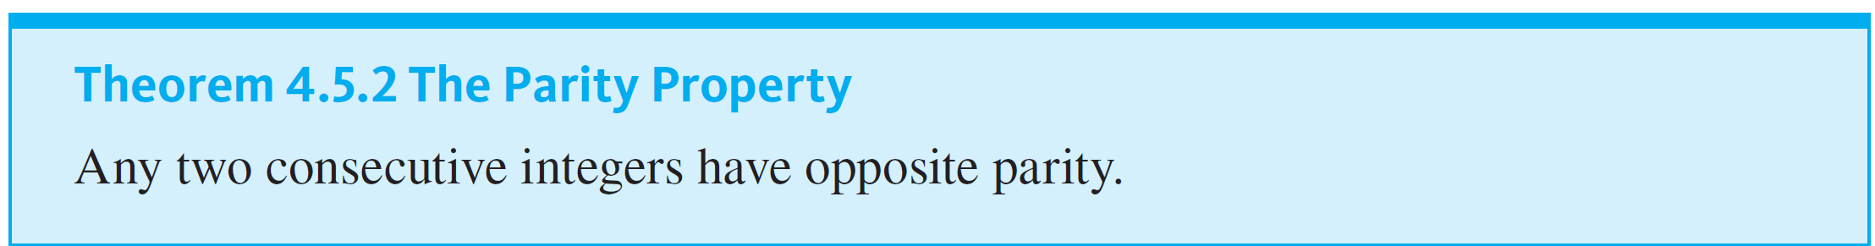
Representations of Integers

Slide 21
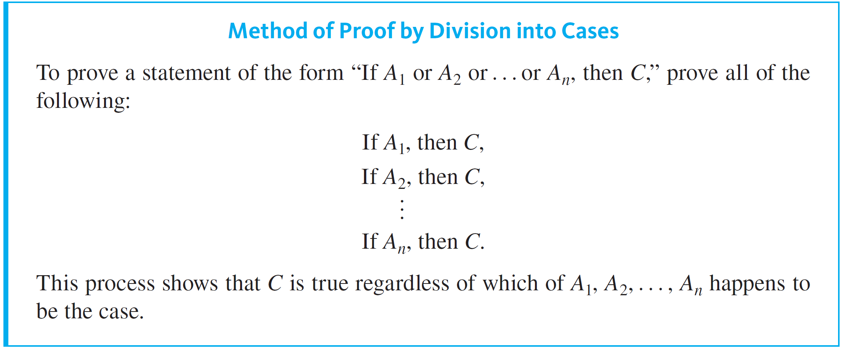
Representations of Integers

Slide 22
Example 4.5.6 – Representing Integers mod 4
Show that any integer can be written in one of the four forms
n = 4q or n = 4q + 1 or n = 4q + 2 or n = 4q + 3
for some integer q.

Slide 23
Example 4.5.6 – Solution
Given any integer n, apply the quotient-remainder theorem to n with the divisor equal to 4. This implies that there exist an integer quotient q and a remainder r such that
n = 4q + r and 0 ≤ r < 4.
But the only nonnegative remainders r that are less than 4 are 0, 1, 2, and 3.
Hence
n = 4q or n = 4q + 1 or n = 4q + 2 or n = 4q + 3
for some integer q. In other words, n mod 4 equals 0, 1, 2, or 3.

Slide 24
Example 4.5.7 – The Square of an Odd Integer
Prove: The square of any odd integer has the form 8m + 1 for some integer m.

Slide 25

Example 4.5.7 – Solution
If checking some examples convinces you that the statement may be true, begin to develop a proof by asking, “Where am I starting from?” and “What do I need to show?” To help answer these questions, introduce variables to rewrite the statement more formally.
Formal Restatement: ∀ odd integer n, ∃ an integer m such that
From this, you can immediately identify the starting point and what is to be shown.

Slide 26





Example 4.5.7 – Solution
continued
Starting Point: Suppose n is a particular but arbitrarily chosen odd integer.
To Show: ∃ an integer m such that
This looks tough. Why should there be an integer m with the property that
That would say that
Perhaps you could make use of the fact that
is an integer, or that 8 divides

Slide 27

Example 4.5.7 – Solution
continued
Does 8 divide (n + 1)(n + 1)? Since n is odd, both (n − 1) and (n + 1) are even. That means that their product is divisible by 4. But that’s not enough. You need to show that the product is divisible by 8.
You could try another approach by arguing that since n is odd, you can represent it as 2q + 1 for some integer q.
Then
It is clear from this analysis that
can be written in the form 4m + 1, but it may not be clear that it can be written as 8m + 1.

Slide 28
Example 4.5.7 – Solution
continued
Yet another possibility is to use the result of Example 4.5.6. That example showed that any integer can be written in one of the four forms 4q, 4q + 1, 4q + 2, or 4q + 3. Two of these, 4q + 1 and 4q + 3, are odd. Thus any odd integer can be written in the form 4q + 1 or 4q + 3 for some integer q. You could try breaking into cases based on these two different forms.

Slide 29
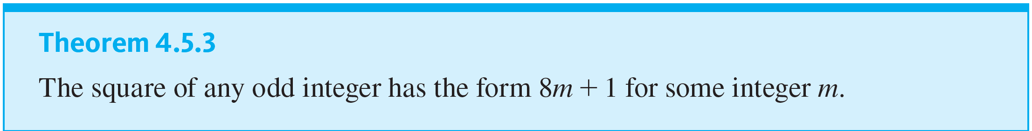
Representations of Integers

Slide 30
Absolute Value and the Triangle Inequality

Slide 31
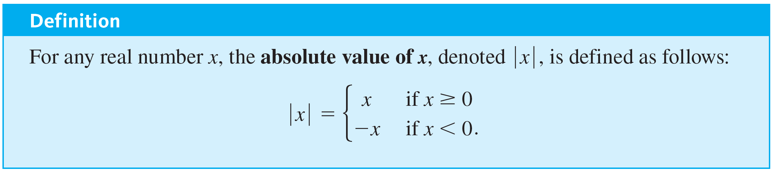
Absolute Value and the Triangle Inequality
The triangle inequality is one of the most important results involving absolute value. It has applications in many areas of mathematics.

Slide 32
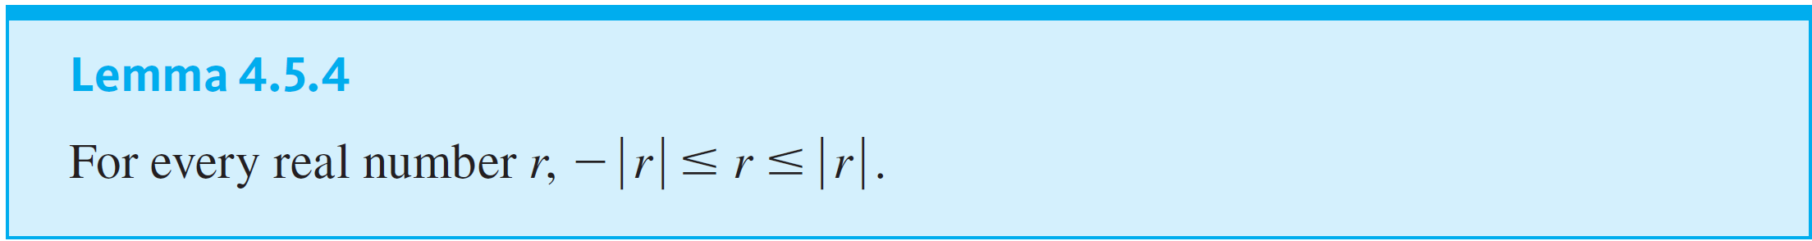
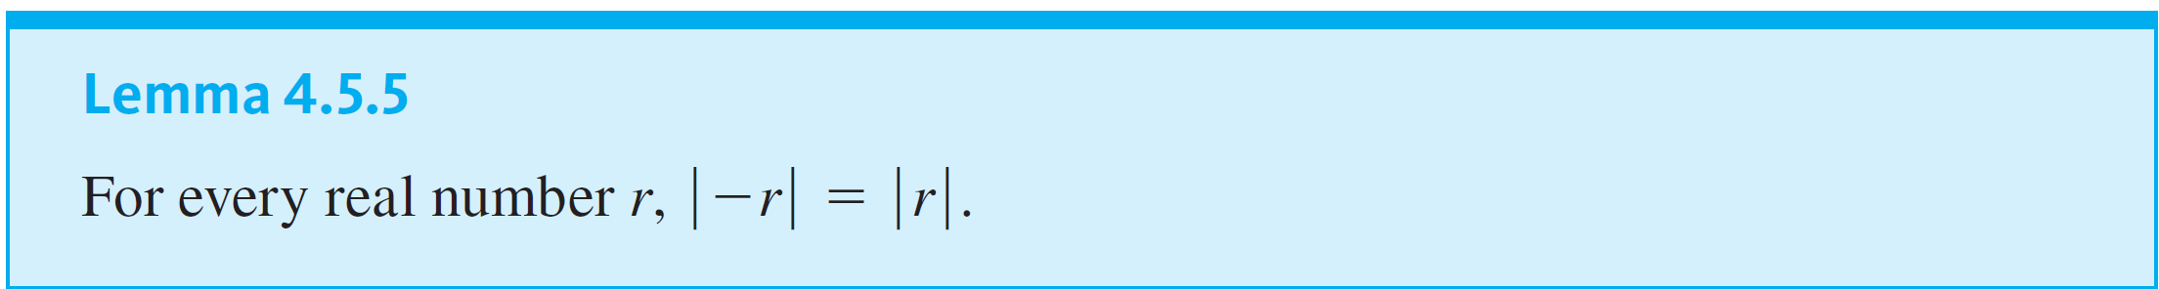
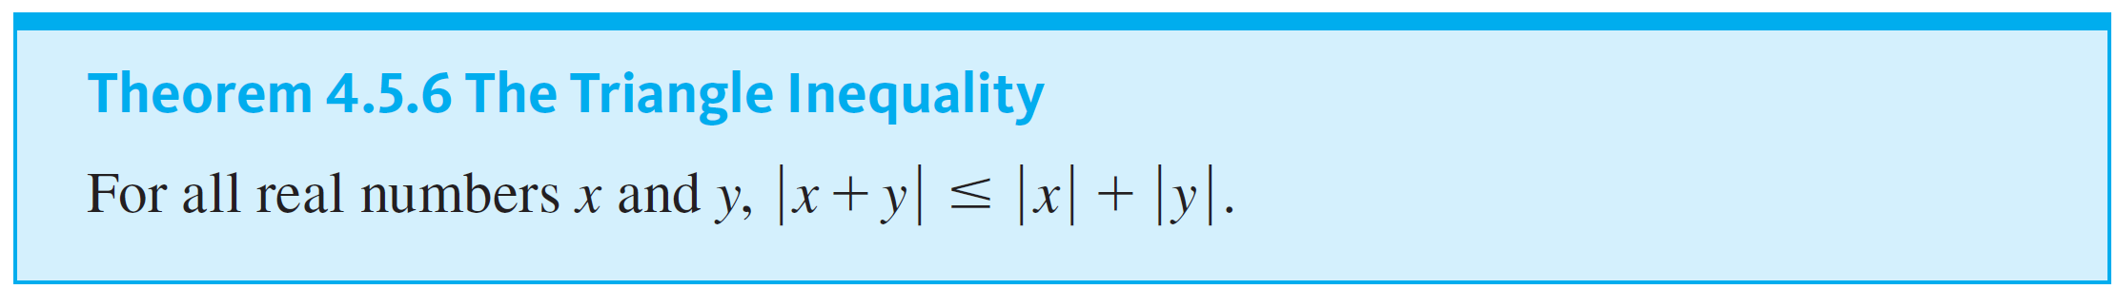
Absolute Value and the Triangle Inequality

